Slide 1
Kelly Wright & Allison Moore
Commencing 15 July 2021

Slide 2
OOHCA in NSW
NSW Ambulance responds to 8000 OOHCA per year
3000 victims with attempts at resuscitation
  Of these, 12% survive to hospital discharge
  Average scene time = 32 minutes
  Current ambulance protocols
    Decisions at 20 minutes
      Paramedics should discontinue resus on scene if PEA/asystole
      Recommended to continue CPR and TF to hospital if any other rhythm
        Discretion allowed
        Currently both “expedited” and “delayed” transfer occur

Slide 3
Expedited transfer of OHCA may/may not be beneficial
transfer of patient too early may compromise good resuscitation
but resuscitation for too long may have diminishing returns.
OHCA with favourable neuro outcome
OHCA with intra-arrest transfer*
Time to ROSC | % patients
0 min | 5%
15 min | 2%
35 min | <1%
Scene time | “risk” of survival
< 15 min | ↓
15 – 30 min | Neutral (OR = 1)
>30 min | ↑
* Study performed without mechanical CPR
Of patients with ROSC…
90% achieve it within 16 minutes

Slide 4
Hypothesis
16 minutes appears to be optimal time for ambulance to transfer to hospital
“expedited care”
Addition of mechanical CPR will likely improve the outcomes for patients requiring intra-arrest transfer
Has implications for funding of LUCAS in ambulances pre-hospital
Looking for survival benefit
Study powered to find increase in neurologically favourable survival from baseline of 5% to 25%
100 patients needed (50 in intervention arm)
Further stratified by initial rhythm (VT/VF or PEA)

Slide 5

Intervention
Expedited bundle of care
  Transfer 15 minutes after paramedics commence resuscitation
  Mechanical CPR for transfer
  Urgent coronary angiography
Randomised controlled trial
  1:1 allocation to intervention vs control arm
  Additional registry comparator arm
  Stratification by initial rhythm (VT/VF) and PEA
  multi-centre, prospective, intention to treat, safety and efficacy clinical trial.
    Many major hospitals involved including POW, Liverpool, St George and St Vincents

Slide 6

Study Schema
Screening
Identify suspected OHCA aged 18 – 70 years
Intensive Care Paramedic arrive on scene with MCPR
Assessed for EVIDENCE trial eligibility
Waiver of consent implemented at this time
Registry
(for individuals who are not eligible for EVIDENCE RCT)
Standard treatment protocols (i.e. no expedited transfer requested)
Those patients transferred to hospital – the same data and CRF is required to be captured as those in RCT
Will also be followed be followed by NSW Cardiac arrest registry
Randomisation (1:1)
- stratified by initial rhythm VT/VF and PEA
Non-expedited transfer (Control arm)
- C2 & C3 protocols
On scene with MCPR
Transfer per standard protocols
At hospital*l
Standard hospital protocols
Expedited transfer (Intervention arm)
C2 protocol
On scene with MCPR
Transfer after 15 minutes of paramedic resuscitation
At hospital *
Expedited transfer to cath lab if initial rhythm VT/VF
*NB Sites with ECMO may have differing protocols
    Follow-up assessment
    In hospital: Routine clinical assessments and outcome assessment captured in medical records;
    Discharge: Consent for continued participation after discharge Mortality, EQ-5D-5L, mRS, CPC, MoCA-BLIND
    6 months post OHCA: Mortality, EQ-5D-5L, mRS, CPC, MoCA-BLIND

Slide 7
Primary Outcome
Mortality at discharge and 6 months
Survival with Cerebral performance category (CPC) 1 or 2
CPC 1 - Good cerebral performance: conscious, alert, able to work, might have mild neurologic or psychologic deficit.
CPC 2 - Moderate cerebral disability: conscious, sufficient cerebral function for independent activities of daily life. Able to work in sheltered environment.
CPC 3 - Severe cerebral disability: conscious, dependent on others for daily support because of impaired brain function. Ranges from ambulatory state to severe dementia or paralysis.
CPC 4 - Coma or vegetative state: any degree of coma without the presence of all brain death criteria. Unawareness, even if appears awake (vegetative state) without interaction with environment; may have spontaneous eye opening and sleep/awake cycles. Cerebral unresponsiveness.
CPC 5 - Brain death: apnoea, areflexia, EEG silence, etc

Slide 8
Secondary outcomes
Overall survival with CPC score 1-2 at 6 months post arrest
expedited vs non-expedited transfer protocol
initial rhythm (VT/VF vs PEA)
MCPR alone vs ECMO CPR
In hours vs out of hours
EtCO2 on arrival to ED as predictor of
ROSC
Survival
Stratified by ETCO₂ 10-20 mmHg, 20-30 mmHg and >30 mmHg on arrival to emergency department
Neurological outcome and Quality of Life (QoL) analysis at on hospital discharge and at 6 months
  Euroqol 5-dimension 5 level preference-based measure of health (EQ-5D-5L)
  modified Rankin scale (mRS<3)
  rapid Montreal Cognitive Assessment instrument (MoCA-BLIND).
Safety: Number of complication rates assigned to MCPR and ECPR.
Effect on ambulance transfer times and arrest to ECMO flow times.
Change in participant transfer numbers pre (historical cardiac arrest registry data) and during the study.
Determine the cost of delivering OHCA care either expedited or non-expedited – see also section 4.4 Economic evaluation

Slide 9

Ambulance will enrol and randomise patients prior to transfer
Inclusions
  Non-traumatic OHCA with suspected medical cause
  Witnessed arrest
  VT/VF (or AED shockable) or PEA as first rhythm
  Bystander CPR < 5 min and ongoing at ambulance arrival
Exclusions
  NOT asystole as first rhythm
  NOT trauma
    May include drowning if no additional trauma
  NOT terminal illness, advanced dementia, applicable advanced care directive
Enrolment is done by paramedic on scene using an app on their car’s smart phone

Slide 10
Ambulance procedures
Pre-hospital notification
Modified 60 second handover from ambulance in resus
  Transfer to ED trolley and ED LUCAS

Slide 11
Implications for ED
Expedited care
In hours only
Monday – Friday
0800 - 1700
If patient is enrolled in hours ED will:
notify cardiology pre-hospital
assemble usual resus team and prepare to follow usual ALS protocols
Aim transfer “expedited care” patients to cath lab <60 min - IN HOURS*
  Senior decision making based on 60 second ambulance handover
  Transfer patient to ED LUCAS arm during ambulance handover
  Ensure functioning ETT prior to cath lab
  Immediately if ROSC en route
  Immediately if VT/VF arrest (even if no ROSC)
    “needle to skin” within 1 hour of arrest time
    Pause in ED to ensure functioning ETT and inclusion/exclusion criteria met
  if PEA arrest
    urgent cath lab if clinically indicated
  In Hours only = Monday – Friday 0800 -1700
All OHCA patients
  to be included in a registry (not just randomised patients)
  Attention to data points including ETCO2 levels & recording of rhythm at each rhythm check

Slide 12
EVIDENCE pager
LAN page 9131
In Hours only
Monday to Friday
0800 - 1700
Pre hospital BAT phone notifications x 2
  when patient has been entered into the trial
  when patient is leaving the scene
ED staff receiving FIRST notification by BAT phone
  LAN page 9131 and state “EVIDENCE in Resus ED” and ETA if known
  Notifications to
    Cardiology AT – attend ED & notify cath lab and interventionalist
    ED CNC Kelly – attend ED for data collection
    Cardiology CNC – for assistance as required
    Wardsmen – attend ED to facilitate transfers
    Bed manager – to facilitate ICU bed post cath lab
Please prepare ED resus team to receive patient (as per usual care) – full PPE in resus 4

Slide 13
“Urgent” coronary angiography?
Cath lab is treatment of T = cardiac thrombus
    Transfer cath lab within 1 hour of arrest
    Transfer cath lab regardless of ROSC for VT/VF arrest
    May be reasonable to go via CT scanner if there is an indication e.g suspected SAH
Check:
  mCPR during extrication and transfer
  Is <1h achievable for arrest to “needle to skin” time < 1 hour
    Need to arrive ED < 50min from arrest time
  Functioning ETT
  If PEA arrest
    Urgent transfer to cath lab only expected if
      ROSC established, or
      Signs of life / ROSC intermittently since arrest
      Indications for cath lab as part of “usual care”
        E.g. existing indication for coronary angiography e.g. known coronary artery disease, suspected MI

Slide 14
ED SMO decision: expedite to cath lab
Only applies to patients randomised to intervention in hours Monday to Friday 0800 – 1700
GO if YES to all
* Arrest time <50 min at arrival to ED?
* Witnessed arrest + bystander CPR
* Initial rhythm VF/VT?
* Age 16-70?
* M-CPR in use?
* No exclusion criteria?
STAY if YES to any
* PEA arrest?
* Suspected traumatic cardiac arrest?
* Nursing home/advanced dementia/terminal illness?
* Specific reason for ED Rx

Slide 15



RESUS 4 – assemble team – full PPE – don’t off load
OOHCA – EVIDENCE TRIAL – p. 9131
AIRWAY MO
AIRWAY RN
Ensure functioning ETT
ED LUCAS ON
NSWAS LUCAS OFF
Transfer LUCAS
AMB Off.
GO if YES to all
* Arrest time <50 min at arrival to ED?
* Witnessed arrest + bystander CPR
* Initial rhythm VF/VT?
* Age 16-70?
* M-CPR in use?
* No exclusion criteria?
STAY if YES to any
* PEA arrest?
* Suspected traumatic cardiac arrest?
* Nursing home/advanced dementia/terminal illness?
* Specific reason for ED Rx
AMB Off.
ED SMO
Decide EXPEDITE to cath lab?
CARDIO AT

Slide 16
Pre-completed note for all OHCA
Open a new progress note for any patient
Cut and paste OHCA template (open linked word document on this slide)
In the top toolbar select “documentation”
Click on “Save as Pre-completed” note
  New dialog box opens
  Edit title e.g. “cardiac arrest template”
  click “save as New”
Close the note and “discard changes” if it doesn’t apply to your current patient.
Add the pre-completed note to your “favourites” so you can find it later
All OHCA patients will be included in a registry (not just randomised patients), so using this standardised note will really help us with the consistency of data collection

Slide 18
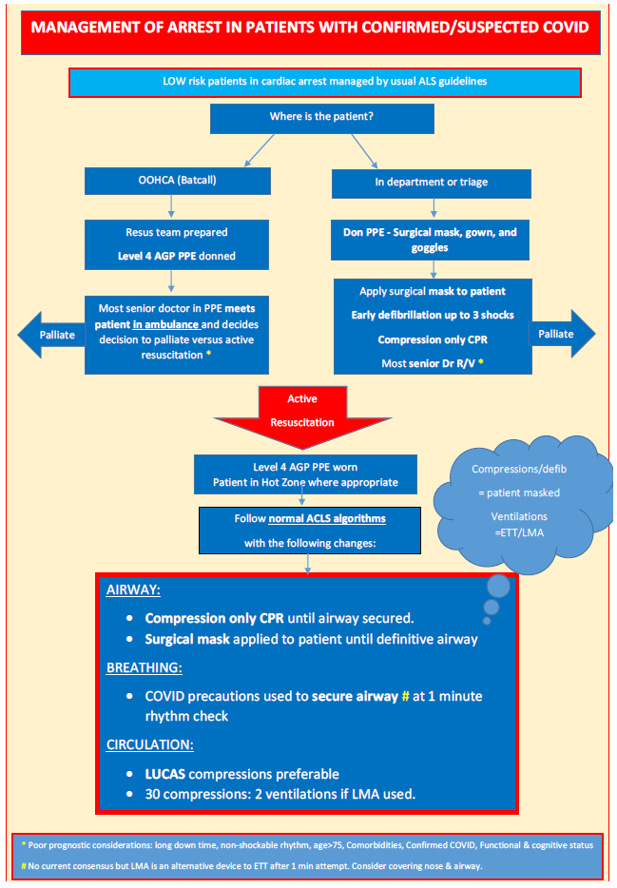

Slide 19
Questions?
Please contact CNC Kelly Wright or Dr Allison Moore

