Slide 1
Is your patient COVID positive?
Quick guide to ED assessment for discharge home

Slide 2
Automated risk stratification process
SARS Cov-2 positive patients are identified by lab
Details are correlated with various NSW health databases through the “Patient Flow Portal” (PFP)
Automated risk score “Risk of Hospitalisation” (ROH) is generated automatically based on health information and demographic details
ROH score will not be accurate if they haven’t had medical issues recorded from recent hospital presentations
Pregnancy is likely to be a common “missed” comorbidity
Clinicians cannot generate a ROH score for their patient
If “very low” – patients receive SMS with details on self-care and how to escalate
The SMS encourages patients to self-contact NSW Health to “upgrade” to a higher risk if they have concerns
Higher ROH scores are statistically associated with increased admissions, ICU admissions, and mortality.

Slide 3
Very low risk patients: Self care
60-80% of patients are likely to be identified as “very low risk”
Very low risk SARS COV-2 positive adult patients receive an automated SMS from PFP
This is sent separately to the patient being notified of their positive result by the lab
They will also receive a message with a link to complete a survey about their contacts from a public health unit.
This service is expanding to include paediatrics (3 months to 16y) from Thurs 23/12 – SMS sent to carer
SMS provides links to a NSW Health self-care information sheet
PDF download - 5 pages long
Links also on the website in various languages
Phone number for clinical concerns 1800 960 933 (Medibank Advice Line)
Advice line may then link to a GP or CTAC/virtual care
Anecdotally, there are long waits on the phone
Can self de-isolate at 10 days AND symptom free for 72h

Slide 4
All other patients are allocated to Virtual care
POW CMC is the main service (based on RPA Virtual model) for SESLHD residents
All new SARS COV-2 positive patients can expect an initial phone assessment
Following phone assessment, the patient is risk stratified to a care protocol
Low risk – self care
Medium risk
Ongoing care from POW CMC virtual service
initial video assessment
Pulse oximeter
Clinical and wellbeing reviews conducted as clinically indicated.
High risk
allocated to STG CTAC virtual service
initial video assessment
Pulse oximeter
Clinical and wellbeing reviews conducted daily
Consider sotrovimab or other evidence-based interventions.
NB: SESLHD is NOT currently allocating patients to GP-based care (although very low risk patients are encouraged to self-refer)
Details for paediatric patients… watch this space!
ACI info: Caring for paediatric patients with COVID 19 in the community

Slide 5
Patients who haven’t yet received notification as “very low risk”
E.g. diagnosed during ED stay
(or yet to receive the message – no information regarding the turnaround time on this)
Clinicians cannot generate a ROH score for their patient
Perform risk assessment using 4663_ACI_Caring for adults and children in community with COVID_clinical and risk assessment.pdf

Slide 6
Risk assessment criteria

Slide 7
Referral to virtual care
For example – your patient has not yet had their initial virtual assessment, or your clinical assessment has moved them to a higher risk category
Low to Medium risk: Prince of Wales CMC – COVID community management centre
Email discharge referrals to: SESLHD-CMC-Admin SESLHD-CMC-Admin@health.nsw.gov.au
Phone contact if required: 0499 435 968
High risk: St George CTAC
Email discharge referrals to: SESLHD-STG-CTAC SESLHD-STG-CTAC@health.nsw.gov.au
Contactable 8am – 8pm on 0400 895 389
Covered overnight by ID (via StG switch)
Details for paediatric patients… watch this space! Probably through SCH virtual KIDS COVID Positive Outpatient Response Team (CORT)
Check your patient is in SESLHD catchment area – they may need to be referred another LHDs community program https://www.health.nsw.gov.au/lhd/Pages/lhd-maps.aspx

Slide 8
Clinical assessment – disease severity
4663_ACI_Caring for adults and children in community with COVID_clinical and risk assessment.pdf
Patients with mild URTI or gastroenteritis symptoms can be assessed clinically:
History
Consider using patient’s mobile phone to decrease your time with the patient
Exam
vital signs, resp distress, hydration status
Postural BP if syncope/pre-syncope; O2 sats post exertion if SOBOE
May not need to auscultate chest; avoid ENT exam unless likely to alter your mx
Investigations
Routine covid bloods NOT necessary, most will not need ANY blood tests
Bedside tests can be performed as indicated: ECG if chest pain or syncope, BSL if vomiting
Their risk factors will then determine allocation to “self-care” or POW CMC or StG CTAC
Patients with moderate or severe disease on clinical assessment will require admission
COVID-19 Power plans are available in EMR for patients warranting admission
Initial investigations
Medications

Slide 9
Clinical assessment – vital signs

Slide 10
Clinical assessment - mild

Slide 11
Clinical assessment - moderate

Slide 12
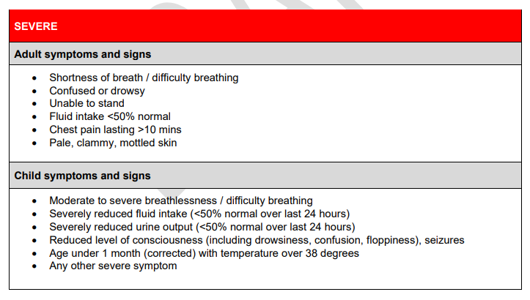
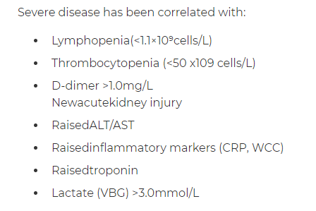
Clinical assessment - severe

Slide 13
Sotrovimab
Patients may be eligible for a dose prior to discharge
Eligibility as per ACI: Model of care for the use of sotrovimab in adults in NSW
Day 1-5
No oxygen requirement (may have minimal symptoms)
Not fully vaccinated (<2 weeks since 2nd dose, ? Not had 3rd dose if immunocompromised)
Comorbidities – includes age >55, obesity, ATSI
Discuss with ID if you believe your patient is eligible
CBR for administration at TSH is being developed
Watch this space

Slide 14
Preparing patient for discharge
All patients should be discharged with written advice:
Managing-mild-COVID-19-at-home-with-assistance-from-your-GP.pdf (racgp.org.au) is a very good document. It includes a diary to record the patient’s symptoms.
NSW Health COVID self-care information sheet (pts should have received a link by SMS)
If relevant
Adult Diarrhoea & Vomiting
Paediatric fever, gastro

Slide 15
Options for Transport Home
Patient Transport – NEPT
NSW ambulance service
Private transport
This is only an ethical option if it is not likely to expose a covid negative person
E.g. getting picked up by mum if mum is already covid positive is OK (Mum needs to wait in the car though!!)
But if mum is covid negative, and patient has been carefully isolating from her, then patient transport is appropriate
No form of public transport (taxi, bus, walking) is acceptable
Other options are not currently available at TSH
A shuttle bus service may become a possiblity, watch this space

Slide 16
Other resources
HealthPathways Sydney COVID-19 Case Management Guidelines: https://sydney.communityhealthpathways.org/723535.htm
NSW Health Patient information (various languages): https://www.health.nsw.gov.au/Infectious/factsheets/Pages/advice-for-confirmed.aspx
RACGP Information for COVID-19 care at home: https://www.racgp.org.au/clinical-resources/covid-19-resources/other-health-issues/covid-19-home-care-guidelines

Slide 17
Text received by very low risk patients
What does the COVID-19 self-managed SMS say?
Dear NAME
This is an official message from NSW Health You have recently tested POSITIVE for COVID-19. If you are under 50 years of age, have had two doses of COVID-19 vaccine and do not suffer from any chronic medical illnesses (listed below). You are at low risk of serious illness and may be able to self-care at home. Most children under 16 years can be safely managed at home, even if not COVID-19 vaccinated.
If this is incorrect or, you are pregnant, please call 1800 960 933, so we can link you in with a health service.
If you have mild symptoms, concerns, or questions, you can call your GP.
If you have a health emergency or are feeling breathless, chest pain or are fainting please call Triple Zero (000) immediately.
For all COVID-19 related information Fact sheets - Confirmed cases of COVID 19
*Medical risk factors include • Obesity • Severe, chronic or complex medical conditions (including cardiac, respiratory, renal or neurodevelopmental) • Diabetes • Immunocompromised including malignancy • Severe mental illnes

